Slide 1
How to make a check on the uniqueness of the 090 call number when saving a record in the metadata editor
Yoel Kortick
Senior Librarian

Slide 2

Agenda
Introduction
Before the configuration change
The configuration change
After the configuration change

Slide 3
Introduction

Slide 4
Introduction
In the example here, we will show to configure Alma to give a warning message when a record is saved with a 090 call number which is the same as that of an existing record.
A similar procedure can be used for other local call number fields as well.

Slide 5
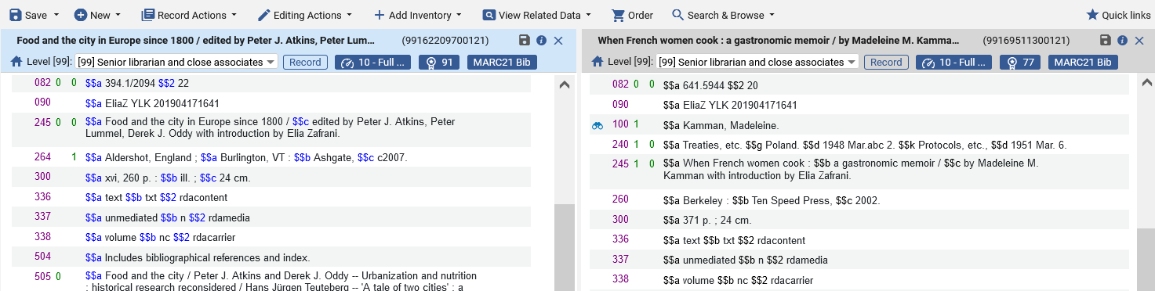
Introduction
There are two bibliographic records with same exact 090 $$a which is: “090 $$a EliaZ YLK 201904171641”

Slide 6
Before the configuration change

Slide 7
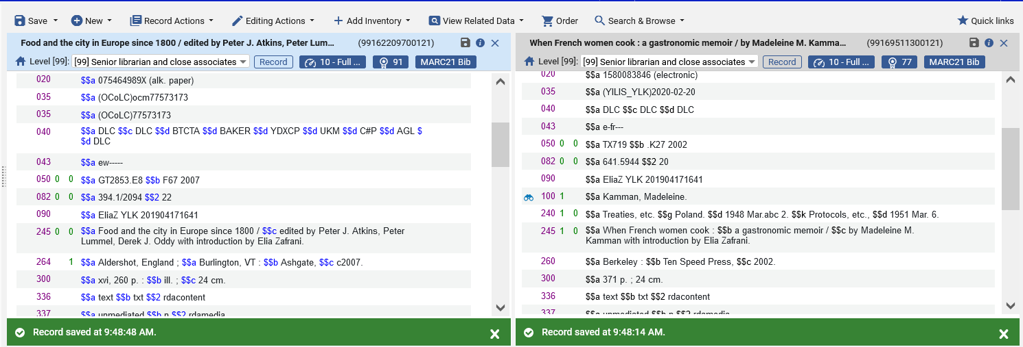
Before the configuration change
Currently when saving the record there is no warning message.

Slide 8
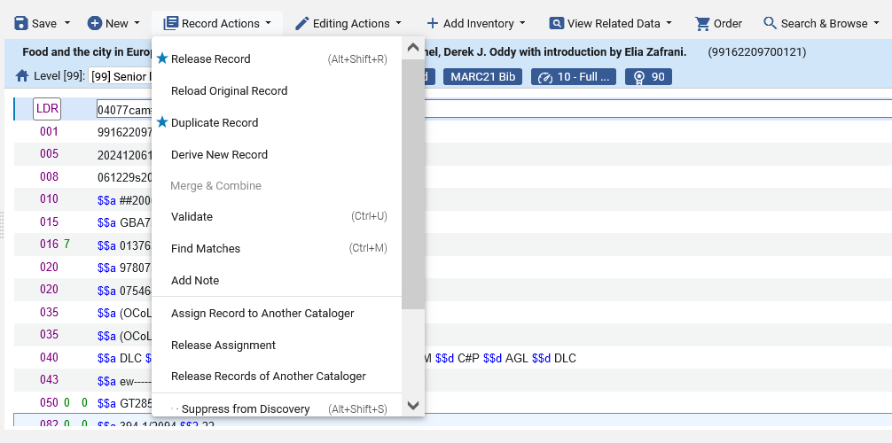
Before the configuration change
There is also no warning message when validating the records (Record Actions > Validate)

Slide 9
The configuration change

Slide 10
The configuration change
We will define the check on the uniqueness of the 090 call number as follows:
Do as follows:
Go to “Configuration > Resources > Cataloging > Metadata Configuration > Marc 21 Bibliographic > Validation Processes”
Edit “Marc21 Bib validation on save”
Click “Add Tasks” and add “Validate Local Call Number Uniqueness MARC21” (if it is not already there in list)
Switch to task parameters and for “VALIDATE LOCAL CALL NUMBER UNIQUENESS” add field 090

Slide 11
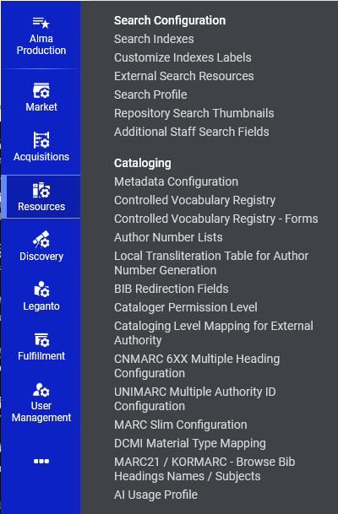
The configuration change

Slide 12
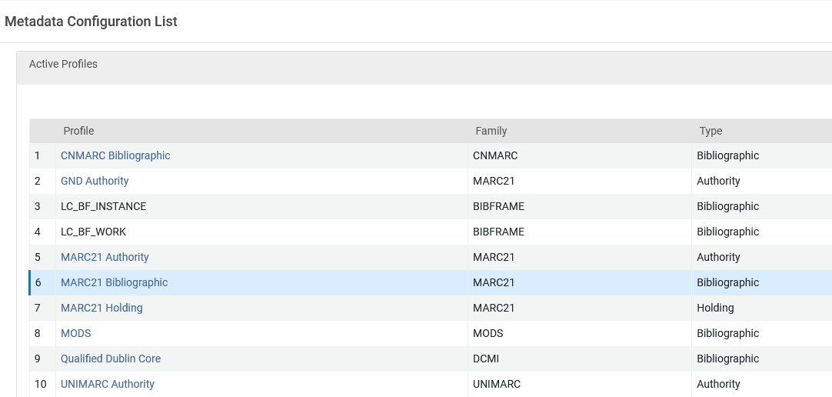
The configuration change

Slide 13
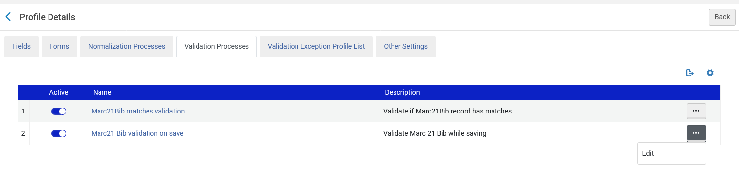
The configuration change

Slide 14
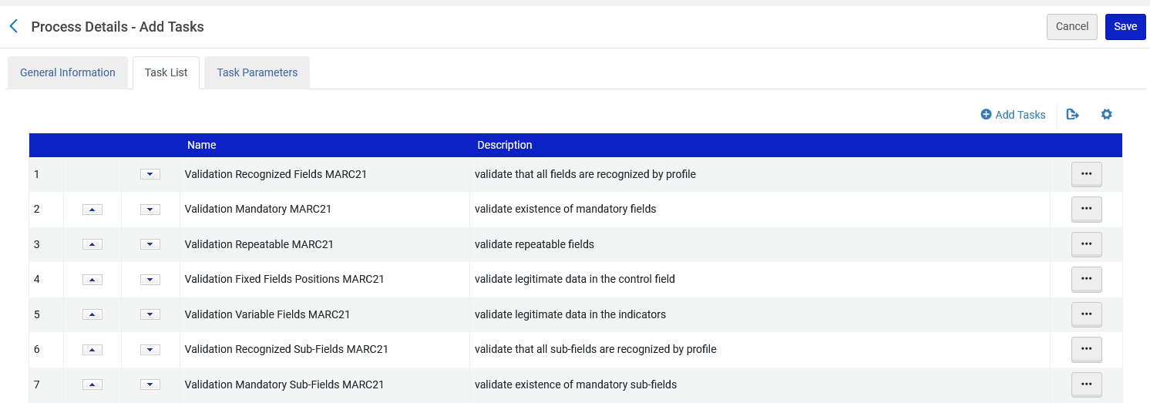
The configuration change

Slide 15
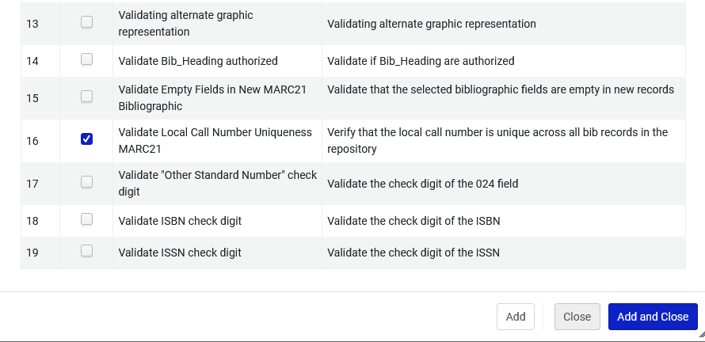
The configuration change

Slide 16
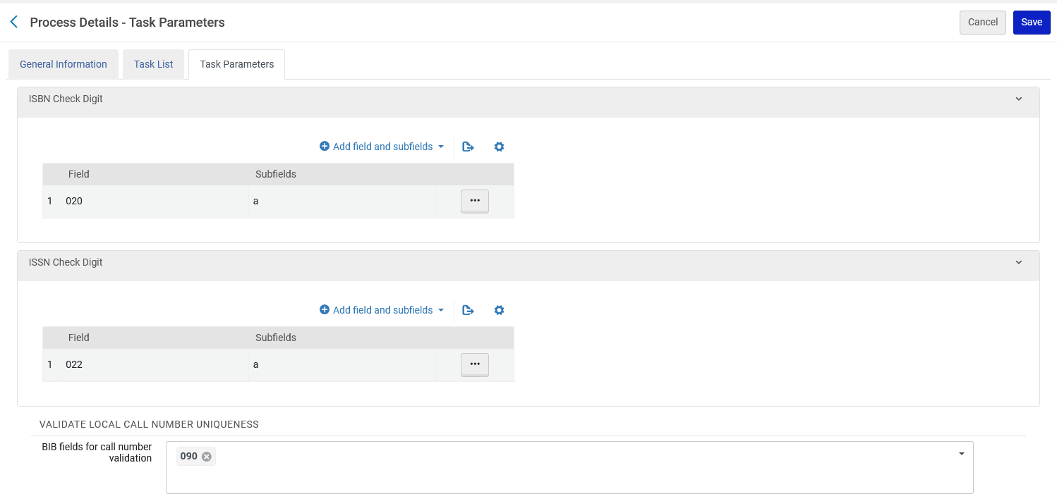
The configuration change

Slide 17
After the configuration change

Slide 18
After the configuration change
Now we will open in the Metadata Editor and try to save one of the two records which has “090 $$a EliaZ YLK 201904171641”
If we try to save one of the records and get message:
The call number is already in use in the record/s [99169511300121]
The message will also appear after doing “Record Actions > Validate”

Slide 19
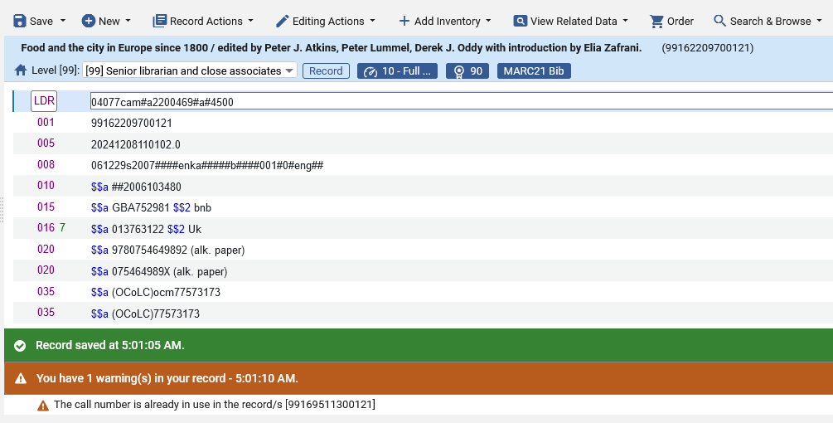
After the configuration change
Message when saving a record

Slide 20
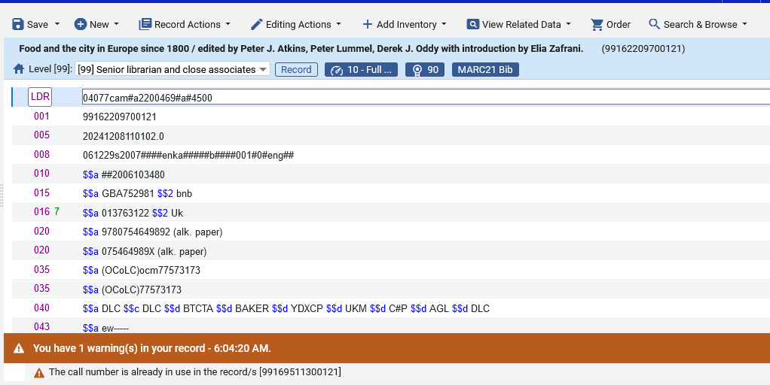
After the configuration change
Message when validating a record

